Slide 1
Class Cancellation updates

Slide 2
What and why???
WHAT IS IT ABOUT?
It is a mobile application that notifies students if there is a class on that subject.
WHY CREATE THIS?
To minimize transport expenses.
To minimize confusion and encourage attendance.
To give students free time to do their unfinished works.

Slide 3
WHO AND HOW
WHO WILL USE?
Faculty members
HOW IT WORKS?
Teachers will notify students through the app if there will be no class on that subject

Slide 4
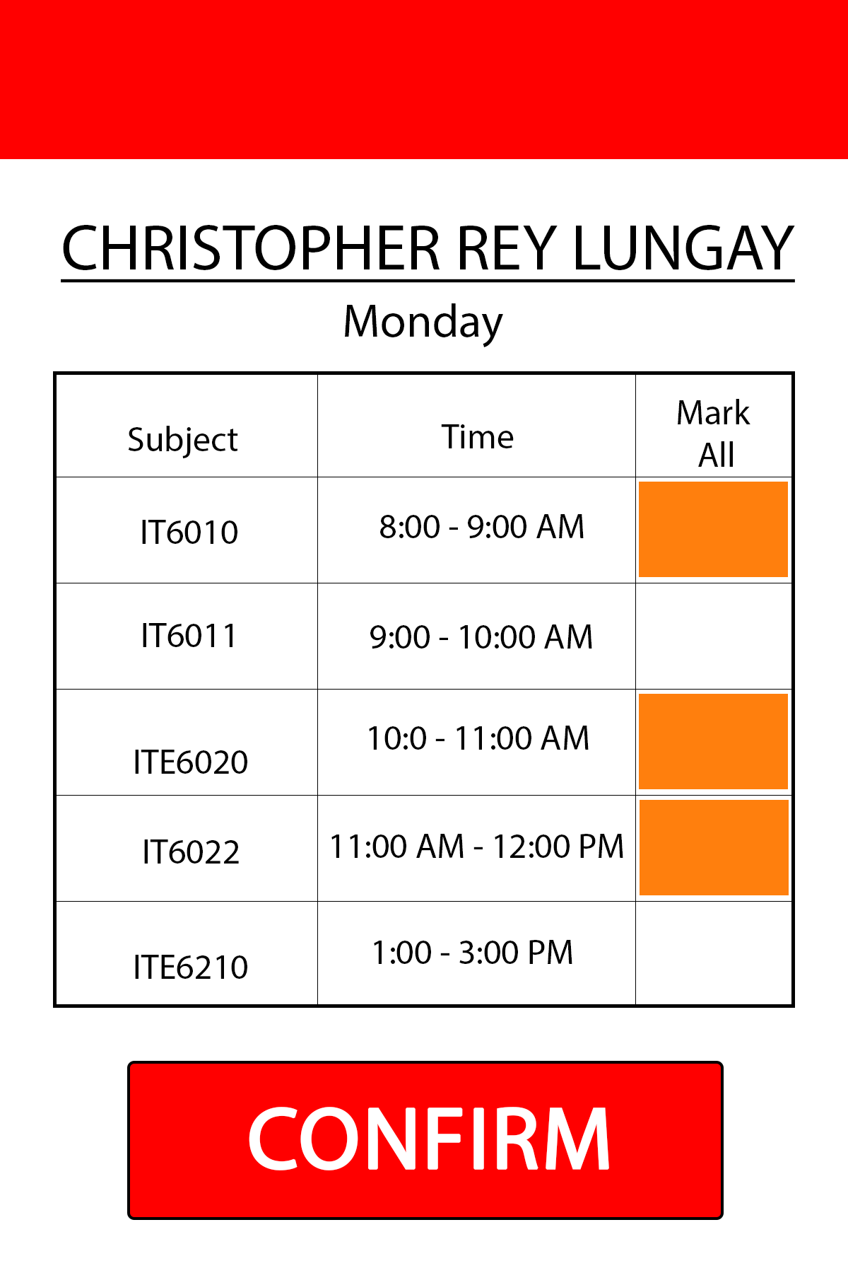

Slide 5
